Slide 1

Basics of Neural Network Programming
Binary Classification

Slide 2
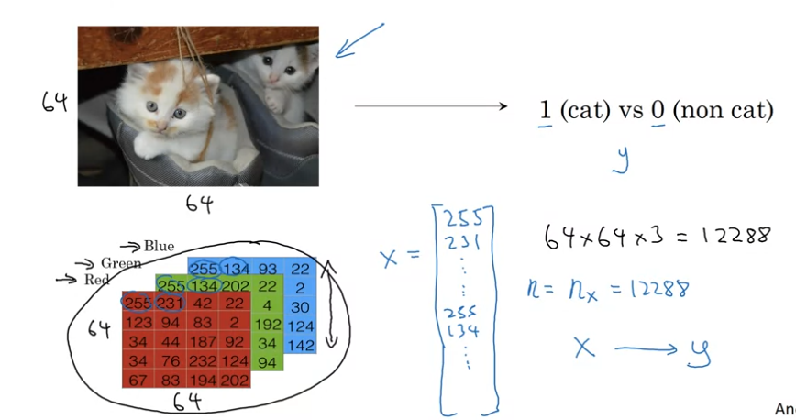
Binary Classification

Slide 3
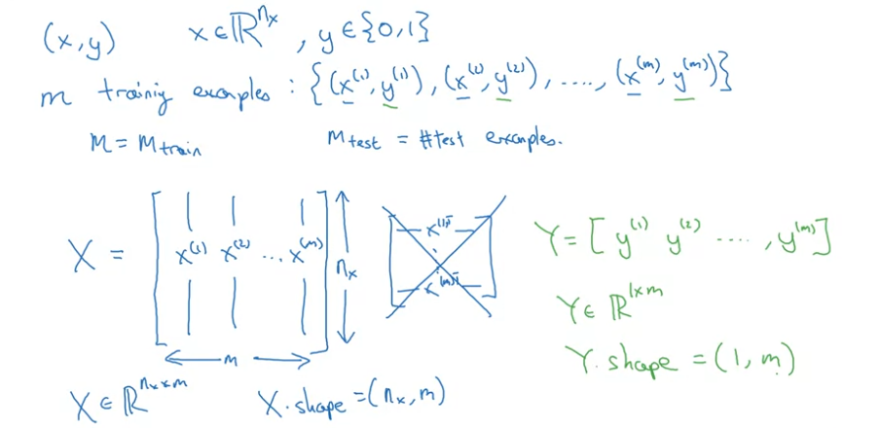
Notation

Slide 4
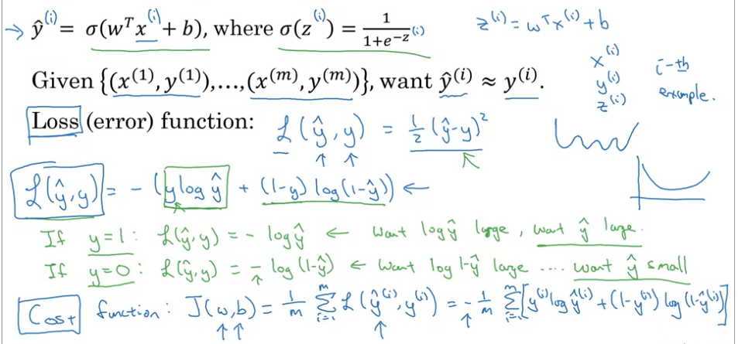
Loss and Cost Function

Slide 5
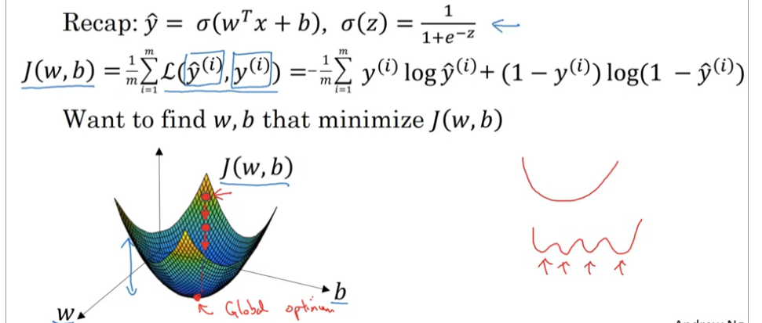
Gradient Descent

Slide 6
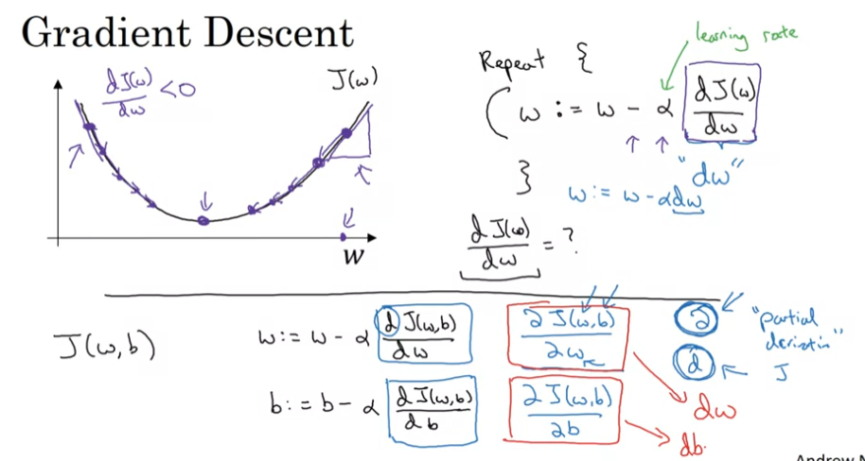
Gradient Descent

Slide 7
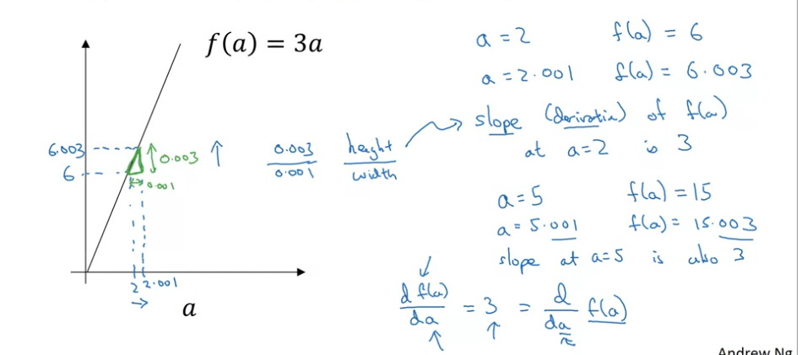
Intuition about derivatives

